Slide 1
This slide is hidden.
Insert the starting slides after this slide

Slide 2

Welcome to St Michael’s
4th Sunday of Lent Year A
You have entered a
SACRED SPACE
– a SACRED TIME...
Please ensure all
mobile phones
are switched off.
Please be respectfully quiet
as we prepare for our celebration.
Notes:
Saturday 5.30PM First Sunday of Advent
MASTER 14th Sunday in Ord Time
MASTER 14th Sunday in Ord Time

Slide 3
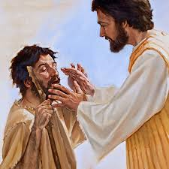
As Jesus went along, he saw a man who had been blind from birth …

Slide 4
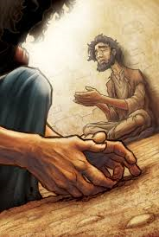
Jesus spat on the ground, made a paste with the spittle, put this over the eyes of the blind man and said to him, 'Go and wash”…

Slide 5
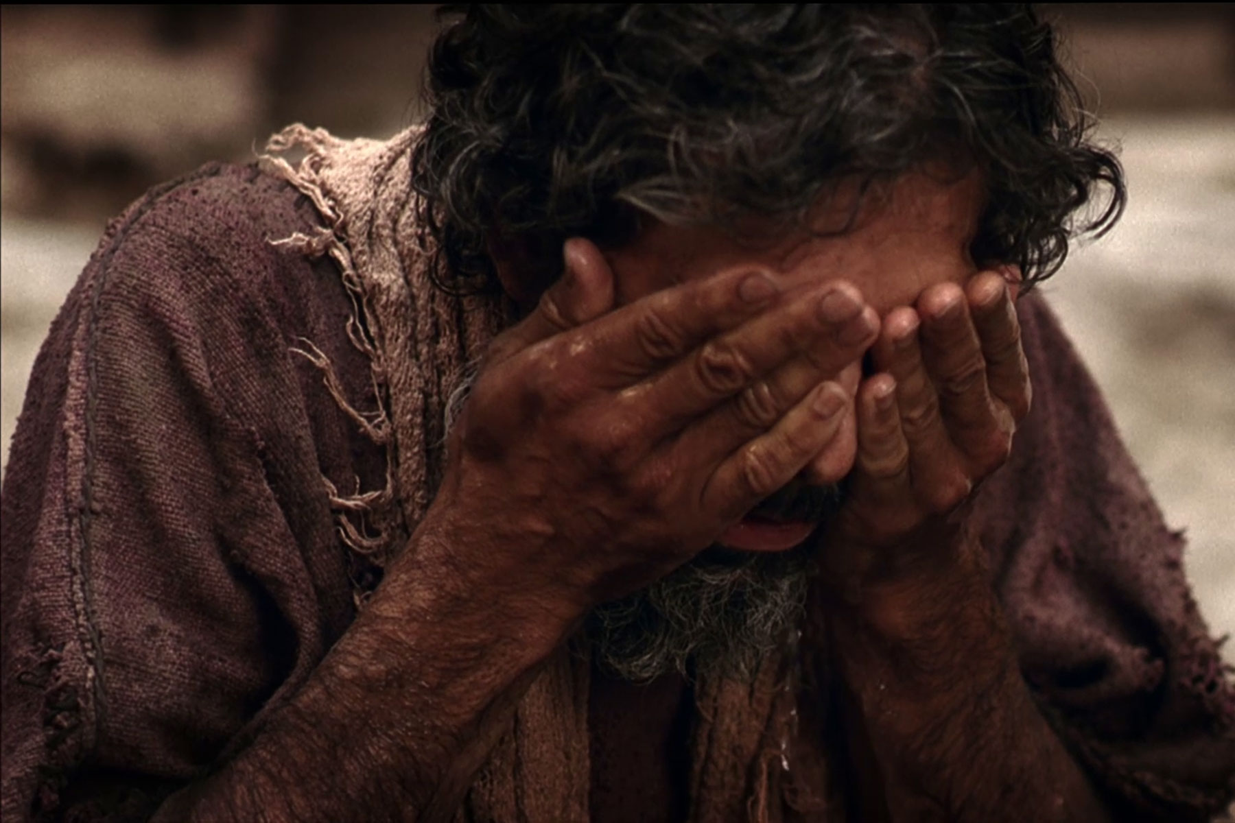
So the blind man went off and washed himself, and came away with his sight restored …

Slide 6

During these days of Lent spend some time considering …
“Where are my blind spots?”

Slide 7
Please Stand

Slide 8
Christ be our light
Longing for light, we wait in darkness.
Longing for truth, we turn to you.
Make us your own, your holy people,
light for the world to see.

Slide 9
Christ, be our light! Shine in our hearts.
Shine through the darkness.
Christ, be our light!
Shine in your church gathered today.

Slide 10
Longing for peace, our world is troubled.
Longing for hope, many despair.
Your word alone has pow’r to save us.
Make us your living voice.

Slide 11
Christ, be our light! Shine in our hearts.
Shine through the darkness.
Christ, be our light!
Shine in your church gathered today.

Slide 12
This slide is hidden.
Insert the Entrance Hymn after this slide

Slide 14
Kyrie eleison
Kyrie eleison (2)
Christe eleison (2)
Kyrie eleison (2)

Slide 16
Gloria
Glory to God in the highest,
and on earth peace to people of good will.
We praise you, we bless you,
we adore you, we glorify you,

Slide 17
We give you thanks for your great glory,
Lord, God heavenly king,
O God, almighty father

Slide 18
Glory to God in the highest,
and on earth peace to people of good will.

Slide 19
Lord Jesus Christ, Only Begotten Son,
Lord God, Lamb of God, Son of the Father,
you take away the sins of the world,
have mercy on us;

Slide 20
you take away the sins of the world, receive our prayer;
you are seated at the right hand of the Father,
have mercy on us.

Slide 21
Glory to God in the highest,
and on earth peace to people of good will.

Slide 22
For you alone are the Holy One,
you alone are the Lord,
you alone are the Most High, Jesus Christ,
with the Holy Spirit,
in the glory of God the Father.

Slide 23
Glory to God in the highest,
and on earth peace to people of good will.
Amen.

Slide 24
Glory to God
Glory to God in the highest,
And on earth peace to people of good will.
We praise you, we bless you,
We adore you, we glorify you

Slide 25
We give you thanks for your great glory,
Lord God heavenly King,
O God, almighty Father

Slide 26
Lord Jesus Christ, only begotten Son,
Lord God, Lamb of God,
Son of the Father,

Slide 27
You take away the sins of the world,
Have mercy on us;
You take away the sins of the world,
Receive our prayer;

Slide 28
You are seated
At the right hand of the Father
Have mercy on us

Slide 29
For you alone are the Holy One,
You alone are the Lord
You alone are the most High,
Jesus Christ

Slide 30
With the Holy Spirit,
In the glory of God the Father.
Amen!
Amen!

Slide 32
Responsorial psalm
The Lord is my Shepherd,
and I want to follow,
wherever he leads me,
wherever he goes.

Slide 33
Over the mountains,
the waters and by-ways,
valleys and highways
he’s waiting for me.

Slide 34
I want to go to meet him there,
to lay myself down in his love.

Slide 35
The Lord is my shepherd,
and I want to follow,
wherever he leads me,
wherever he goes.

Slide 36
And while on the journey
to where we are going,
he promised to be there
to help us along.

Slide 37
And over the mountains
we’ll walk on together,
to know all the wonders
he’s given to me

Slide 38
I want to go to meet him there,
to lay myself down in his love.

Slide 39
The Lord is my shepherd,
and I want to follow,
wherever he leads me,
wherever he goes.

Slide 41
Alleluia
Praise and honour to you, Lord Jesus, Christ (2)

Slide 43
Apostles Creed
I believe in God,
the Father almighty,
Creator of heaven and earth,
and in Jesus Christ, his only Son, our Lord,
(At the words that follow, up to and including the Virgin Mary, all bow.)

Slide 44
who was conceived by the Holy Spirit,
born of the Virgin Mary,
suffered under Pontius Pilate,
was crucified, died and was buried;
he descended into hell;

Slide 45
on the third day he rose again from the dead;
he ascended into heaven,
and is seated at the right hand of God the Father almighty;

Slide 46
from there he will come to judge the living and the dead.
I believe in the Holy Spirit,
the holy catholic Church,

Slide 47
the communion of saints,
the forgiveness of sins,
the resurrection of the body,
and life everlasting.
Amen.

Slide 49
First Collection
This collection goes to the Bishop
for the support of the Diocese.
Thank you for your contribution

Slide 51
This slide is hidden.
Insert the Offertory Hymn after this slide.

Slide 52

Lord, I offer my life
All that I am, all that I have
I lay them down before you, oh Lord
All my regrets, all my acclaims
The joy and the pain,
I'm making them yours

Slide 53
Lord, I offer my life to you
Everything I've been through
Use it for your glory

Slide 54
Lord I offer my days to you
Lifting my praise to you
As a pleasing sacrifice
Lord I offer you my life

Slide 55
Things in the past, things yet unseen
Wishes and dreams
that are yet to come true
All of my hopes, all of my plans
My heart and my hands are lifted to you

Slide 56
Lord, I offer my life to you
Everything I've been through
Use it for your glory

Slide 57
Lord I offer my days to you
Lifting my praise to you
As a pleasing sacrifice
Lord I offer you my life

Slide 58
What can we give that you have not given?
And what do we have
That is not already yours?
All we possess are these lives we're living
That's what we give to you, Lord

Slide 59
Lord, I offer my life to you
Everything I've been through
Use it for your glory

Slide 60
Lord I offer my days to you
Lifting my praise to you
As a pleasing sacrifice
Lord I offer you my life

Slide 62
Priest: Pray my brothers and sisters,
that my sacrifice and yours may be
acceptable to God, the almighty Father.
All: May the Lord accept the sacrifice
at your hands for the praise and glory of his name, for our good and the good of all his holy Church.

Slide 63
Priest: The Lord be with you.
All: And with your spirit.
Priest: Lift up your hearts.
All: We lift them up to the Lord.

Slide 64
Priest: Let us give thanks to the
Lord our God.
All: It is right and just.

Slide 66
Holy
Holy, Holy, Holy Lord God of hosts,
Heaven and earth are full of your glory. Hosanna in the highest
Blessed is he who comes
in the name of Lord,
Hosanna in the highest.

Slide 68
Memorial acclamation
Save us saviour of the world,
For by your cross and resurrection,
You have set us free

Slide 69
Memorial acclamation
When we eat this bread
And drink this cup
We proclaim your death O Lord
Until you come again

Slide 70
Memorial acclamation
We proclaim your death O Lord
And profess your resurrection
Until you come again

Slide 72
Amen
Amen, amen, amen, amen.
Amen, amen, amen, amen.

Slide 74
Priest: The Lord be with you.
All: And with your spirit

Slide 76
Peace
May the peace of the Lord be with you
With your friends and your family too
Let it be, let it grow
And everywhere you go
May the peace of the Lord follow you

Slide 77
Lamb of God
Lamb of God, lamb of God
You take away the sins of the world
Have mercy on us, lamb of God

Slide 78
Lamb of God, lamb of God
You take away the sins of the world
Have mercy on us, lamb of God

Slide 79
Lamb of God, lamb of God
You take away the sins of the world
Grant us, grant us peace

Slide 81
Priest: Behold the Lamb of God, behold him
who takes away the sins of the world.
Blessed are those called to the supper of the Lamb.
All: Lord, I am not worthy
that you should enter under my roof,
but only say the word
and my soul shall be healed.

Slide 82
This slide is hidden.
Insert the Communion Hymns after this slide.

Slide 83
I am the bread of life
I am the bread of life,
He who comes to me shall not hunger,
He who believes in me shall not thirst.
No one can come to me
Unless the Father draw him.

Slide 84
And I will raise him up,
And I will raise him up,
And I will raise him up on the last day.

Slide 85
The bread that I will give
Is my flesh for the life of the world,
And he who eats of this bread,
He shall live for ever,
He shall live for ever.

Slide 86
And I will raise him up,
And I will raise him up,
And I will raise him up on the last day.

Slide 87
Unless you eat of the flesh
Of the Son of Man,
And drink of His blood
And drink of His blood,
You shall not have life within you

Slide 88
And I will raise him up,
And I will raise him up,
And I will raise him up on the last day.

Slide 89
And I will raise him up,
And I will raise him up,
And I will raise him up on the last day.

Slide 90
Open my eyes, Lord
Open my eyes, Lord, I want to see Jesus,
To reach out and touch Him,
And say that I love Him.
Open my ears, Lord, And help me to listen,
Open my eyes, Lord, I want to see Jesus.

Slide 91
Open our eyes, Lord, we want to see Jesus,
To reach out and touch Him,
And say that we love Him.
Open our ears, Lord, and help us to listen,
Open our eyes, Lord, we want to see Jesus.

Slide 92
Thy Word
Thy Word is a lamp unto my feet
And a light unto my path
Thy Word is a lamp unto my feet
And a light unto my path

Slide 93
When I feel afraid
And think I've lost my way
Still You're there right beside me
And nothing will I fear
As long as You are near
Please be near me 'til the end

Slide 94
Thy Word is a lamp unto my feet
And a light unto my path
Thy Word is a lamp unto my feet
And a light unto my path

Slide 95
I will not forget Your love for me, and yet
My heart forever is wandering
Jesus be my Guide,
And hold me to Your side
And I will love You 'til the end

Slide 96
Thy Word is a lamp unto my feet
And a light unto my path
Thy Word is a lamp unto my feet
And a light unto my path

Slide 97
Nothing will I fear as long as You are near
Please be near me 'til the end

Slide 98
Thy Word is a lamp unto my feet
And a light unto my path
Thy Word is a lamp unto my feet
And a light unto my path

Slide 99
This slide is hidden.
Insert the Notices for the week after this slide

Slide 100

STATIONS OF THE CROSS
Friday 7.00pm at St Michael’s
Saturday 9.30am at St Patrick’s

Slide 101

PROJECT COMPASSION
Let’s work together to end poverty,
promote justice and uphold dignity.
Notes:
7am - 14th Sunday in Ord Time
7am - 14th Sunday in Ord Time

Slide 102

NEW MASS TIMES
begin Tuesday 1 April!
Daylight Saving ends next Sunday 6 April

Slide 103

WANTED for PALM SUNDAY
Palm Branches
Olive Branches

Slide 104

Could you be one of the 12?
‘’Twelve Apostles required for 7.30pm Mass of the Lord’s Supper - Holy Thursday 17 April. Registration Clipboard located at the Main entrance, at the back of the Church.

Slide 105

SVDP PANTRY
Tinned spaghetti, tinned fish, soup, spreads (honey, jam, vegemite—no peanut butter please!) and Soap.
Thank you for your generosity!

Slide 106

Please take home your bulletin or download it www.stmichaelsparish.com
www.facebook.com/blacktowncatholics
Notes:
7am - 14th Sunday in Ord Time
7am - 14th Sunday in Ord Time

Slide 107
This slide is hidden.
The next slide can be used for videos.
Insert the video into the slide.

Slide 109
Priest: The Lord be with you.
All: And with your spirit.

Slide 111
This slide is hidden.
Insert the Recessional Hymns after this slide.

Slide 112
Give thanks
Give thanks with a grateful heart
Give thanks to the Holy One
Give thanks because He's given Jesus Christ, His Son

Slide 113
Give thanks with a grateful heart
Give thanks to the Holy One
Give thanks because He's given Jesus Christ, His Son

Slide 114
And now let the weak say, "I am strong"
Let the poor say, "I am rich
Because of what the Lord has done for us"

Slide 115
And now let the weak say, "I am strong"
Let the poor say, "I am rich
Because of what the Lord has done for us"

Slide 116
Give thanks with a grateful heart
Give thanks to the Holy One
Give thanks because He's given Jesus Christ, His Son

Slide 117
Give thanks with a grateful heart
Give thanks to the Holy One
Give thanks because He's given Jesus Christ, His Son

Slide 118
And now let the weak say, "I am strong"
Let the poor say, "I am rich
Because of what the Lord has done for us"

Slide 119
And now let the weak say, "I am strong"
Let the poor say, "I am rich
Because of what the Lord has done for us"
Give thanks.

Slide 120
This slide is hidden.
Insert the final slide here.

